Slide 1
Toward Whole-Session Relevance: Exploring Intrinsic Diversity in Web Search
Date: 2014/5/20
Author: Karthik Raman, Paul N. Bennett, Kevyn Collins-Thompson
Source: SIGIR’13
Advisor: Jia-Ling Koh
Speaker: Pei-Hao Wu

Slide 2
Outline
Introduction
Method
Experiments
Conclusion

Slide 3
Introduction
Traditional (extrinsic) diversity
Ambiguity in user intent
Intrinsic Diversity
Single topical intent but diverse across different aspects

Slide 4
Introduction
Typical search model :
Present results maximizing relevance to current query
NatGeo page on snow leopards
Snowleopard.org new article
News about snow leopards in Cape May
BBC video on snow leopards triplets

Slide 5
Introduction
Intrinsic Diversity (ID)
focus on many complex tasks ,
i.e. require multiple queries to complete the task

Slide 6
Introduction
Intrinsic Diversity (ID)
Initiator query
NatGeo page on snow leopards
Snow Leopard Habitats
Snow leopards Life Cycle
Successor query
Snow Leopards in the Wild
Snow Leopards in Zoos.
Snow Leopards Pictures and Videos.

Slide 7
Introduction
Structure
Find ID session from log
Predict whether initiator query
Rank results
to User
User input query

Slide 8
Outline
Introduction
Method
Experiments
Conclusion

Slide 9
Find ID Session From Log- Extraction Algorithm
facebook
remodeling ideas
ideas for remodeling
cost of typical remodel
hardwood flooring
walmart
earthquake retrofit
paint colors
dublin tourism
kitchen remodel
Paint roof
Paint roof
…..(more than 50 characters)
remodeling ideas
ideas for remodeling
cost of typical remodel
hardwood flooring
earthquake retrofit
paint colors
dublin tourism
kitchen remodel
Paint roof
1. Remove frequent queries, like as facebook or walmart
2. Collapse duplicates
3. Only preserve manually entered queries
4. Remove sessions with no SAT Document
5. Remove long queries

Slide 10
Find ID Session From Log- Extraction Algorithm
remodeling ideas
ideas for remodeling
cost of typical remodel
hardwood flooring
earthquake retrofit
paint colors
dublin tourism
kitchen remodel
Paint roof
remodeling ideas
ideas for remodeling
cost of typical remodel
hardwood flooring
earthquake retrofit
paint colors
kitchen remodel
Paint roof
6. Ensure topical coherence:
successor query need to share at least one common top ten result with the initiator query

Slide 11
Find ID Session From Log- Extraction Algorithm
remodeling ideas
ideas for remodeling(0.77)
cost of typical remodel(0.22)
hardwood flooring(0)
earthquake retrofit(0)
paint colors(0.33)
kitchen remodel(0.47)
Paint roof(0.44)
remodeling ideas
cost of typical remodel
hardwood flooring
earthquake retrofit
paint colors
kitchen remodel
Paint roof
(7 distinct aspects)
7. Ensure diversity in aspects:
Used character-based trigram cosine similarity and remove queries where the similarity was more than 0.5
8. Threshold the number of distinct aspects:
Any session with less than three distinct aspects

Slide 12
Predict whether initiator query-SVMs
Using SVMs to classification the Query ID or Regular
Features: Text, Stats, POS, ODP, QLOG
ID query
query
SVMs
Regular query

Slide 13
Rank results to User- Greedy-DynRR Algorithm
Give a query q and then produce ranking document d₁,d₂ .. (with associated aspects q₁,q₂ ..)
Based on four conditions:
Document should be relevant to query q
Document d_{i} should be relevant to associated aspect q_{i}
Aspect should be relevant to the ID task being initiated by query q
Aspect should be diversity

Slide 14
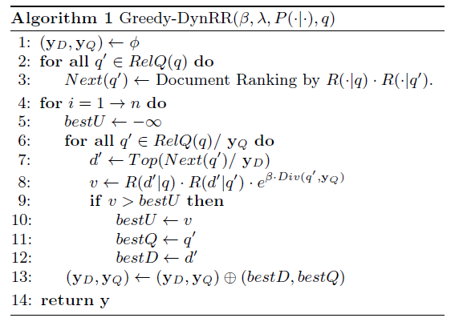
Rank results to User- Greedy-DynRR Algorithm
y_{D=}d1,d2…
y_{Q=}q1,q2…
q=initiator query

Slide 15
Outline
Introduction
Method
Experiments
Conclusion

Slide 16
Find ID Session From Log- Extraction Algorithm
Data source: the search log from the period April 1-May 31, 2012
Data: 51.2M sessions comprising 134M queries
Running the extraction algorithm can get 497K ID sessions with 7M queries

Slide 17
Find ID Session From Log- Extraction Algorithm
Evaluating Extraction Algorithm by two annotators
Data set: sample 150 sessions (75 ID sessions, 75 Regular sessions)
With enough data, we can overcome the noise
Annotator agreement | Algorithm precision | Algorithm accuracy
79% | 73.9% | 73.7%

Slide 18
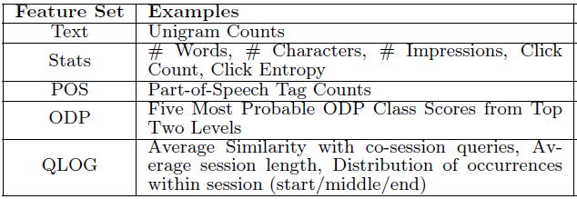
Predict whether initiator query-SVMs
Data source: from Extraction Algorithm
Data: 61K queries ( 50000 training, 3000 validation, 8000 test )
Features:

Slide 19
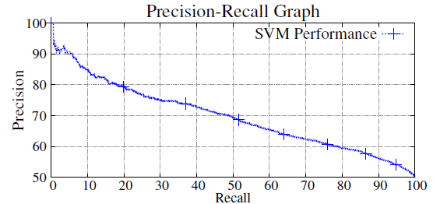
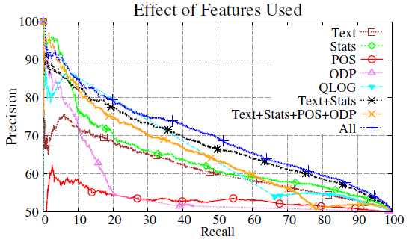
Predict whether initiator query-SVMs
With all features
Can identify 20% of ID with 80% precision
Combine Text and Stats features can get good effect than either alone

Slide 20
Rank results to User- Greedy-DynRR Algorithm
Data:
(1) MINED: from Extraction Algorithm by setting the threshold less than five distinct aspects
(2) MIXED: from MINED dataset session and random sample of regular session

Slide 21
Rank results to User- Greedy-DynRR Algorithm
Obtain Probability of Relevance
(1)Baseline: a state-of-the-art commercial search engine ranker
(2) RelDQ: ranking with R(d|q)

Slide 22
Outline
Introduction
Method
Experiments
Conclusion

Slide 23
Conclusion
Presented a method to get Intrinsic Diversity for web search
Presented a method to predict ID initiation
Presented an approach to rank information on aspects of the task for which the user will search in the future

